Slide 1
Data Wrangling – Part 5

Slide 2
arrange() Function
Command Illustration
new_dataframe_name <- dataframe_name %>%
arrange(column_name)

Slide 3
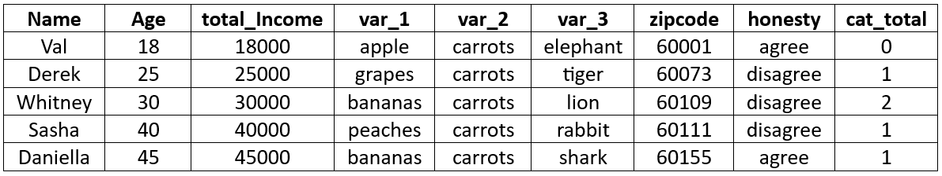
Illustration_Data

Slide 4
Example 1: Arrange data by "cat_total" in ascending order (smallest to largest)
example_1<-Illustration_Data %>%
arrange(cat_total)

Slide 5
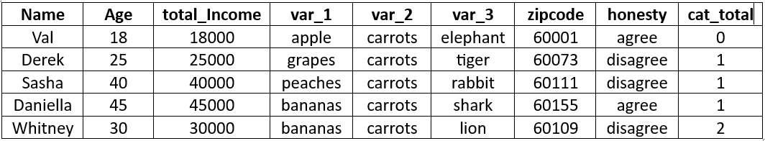
Output will be a dataframe that looks like:

Slide 6
Example 2: Arrange data by "cat_total" in descending order (largest to smallest).
example_2<-Illustration_Data %>%
arrange(desc(cat_total))

Slide 7
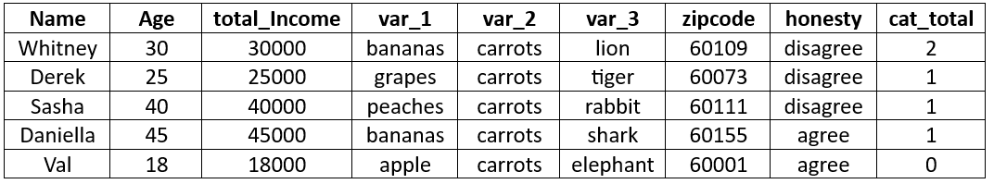
Output will be a dataframe that looks like:

Slide 8
Example 3:Arrange data in alphabetical order by name.
example_3<-Illustration_Data %>%
arrange(Name)

Slide 9
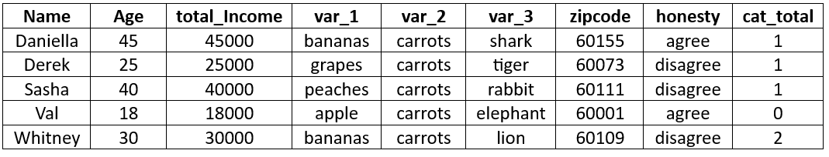
Output will be a dataframe that looks like:

Slide 10
Example 4: Count the number of occurrences each fruit had in "var_1"
example_4<-Illustration_Data %>%
group_by(var_1) %>%
summarize(N = n())

Slide 11
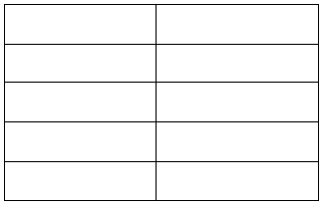
Example 4: Count the number of occurrences each fruit had in "var_1"
example_4<-Illustration_Data %>%
group_by(var_1) %>%
summarize(N = n())
Output will be a dataframe that looks like:

Slide 12
Example 5: Arrange by honesty and within category of honesty, arrange by cat_total.
example_5 <- Illustration_Data %>%
arrange(honesty, cat_total)

Slide 13
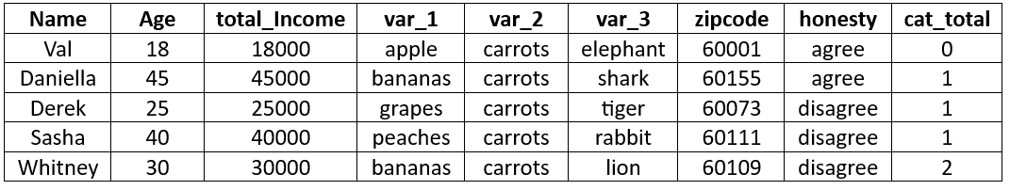
Output will be a dataframe that looks like:

